Slide 1











Graph Quantization
Lemma 1: Any previously seen example is within 2R of at least one vertex
Lemma 2: R is within the multiplicative factor of 4 of the optimal solution to the offline k-center clustering problem (NP hard)
Nick
R
2R
2R
R
Sumeet

Slide 2
Regularization
Low
confidence
labeled data
ONLY LABELED ALL DATA
Notes:
There is a parameter that we introduced by this SINK, and that is how big of a weight we put on those
Just labeled data … all data na x os
Interpolaciu medzi unlabeled and just labeled …. All data (naprava) …
Treba popisat obrazky

Slide 3

Parameterization
The maximum number of representative vertices k
Impacts the accuracy of the approximation and is limited by the computational power of the system
The minimum edge ε in the graph W and regularization parameter γ_{g}
Both affect the precision and recall of the system
For simplicity, the parameter γ_{g} can be set as γ_{g} = 10ε
Nick
0.9
0.6
0.2
1.0
0.0
0.8
0.0
-0.1
-1.0
0.7
-0.9
-0.5
Sumeet
Real-Time Learning without Explicit Feedback. In Proceedings of the 4th IEEE Online Learning for Computer Vision Workshop, San Francisco, California, June 2010. Best paper award.

Slide 4
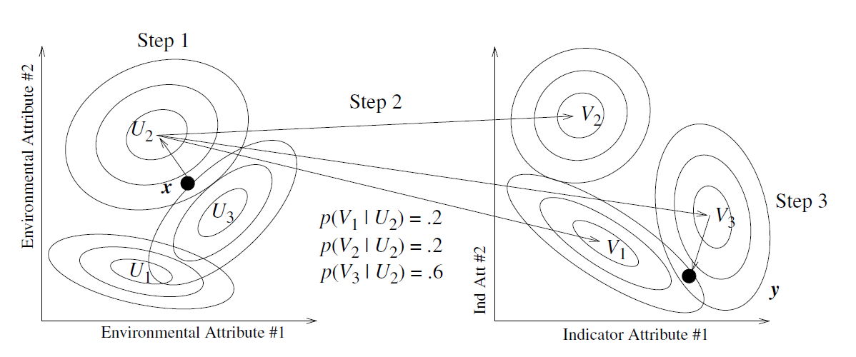
Related Work (CAD)
Conditional Anomaly Detection - Song (2007)
Uses EM to fit mixture of multivariate Gaussians and the mapping function p
Cannot influence
Can influence
Task: detect anomalies in indicator attributes wrt. environmental attributes
Notes:
For the sake of time. I will not talk about specific traditional anomaly detection methods.
They are described in the proposal document.
I describe couple very related methods: First one, is called CAD and divides all data attributes into 2 group E na Indicators.
Both of the groups are model with the mixtures of the multivariate Gaussians and the model includes the probabilitic
mapping function between those.
The biggest problem besides many parameters to learn and the locality of the EM
are the distributional assumptions, where some of the data we are dealing with are not even continuos.

Slide 5
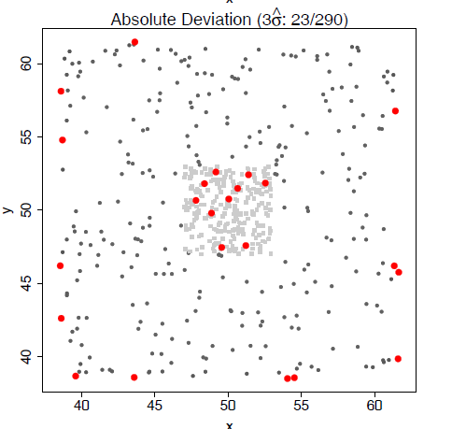
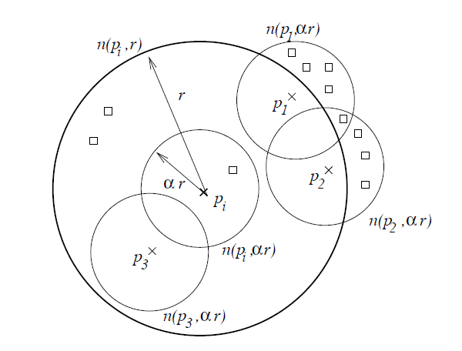
Related Work (CAD)
Cross Outlier Detection (Papadimitriou, 2003)
Fringe points
Notes:
The other related work is cross outlier detection, which compares the neighborhood counts.
The point is a cross-outlier if his neighborhood is different from his same-class neighbor neighborhoods.
A statistic from these quantities is defined and points with beyond 3std are declared anomalous.
As the authors claim, the disadvantage of this method is the fringe points, because they have different
neighborhoods than the points within the support.

Slide 6
Theoretical Analysis
Prove a bound of the form:
The bound can be proved when the constraints in the regularized HFS are enforced in a soft manner:
Error of our solution
Empirical risk on labeled vertices
K = L + γ_{g}I
C is a diagonal matrix such that C_{ii} = c_{l} for all labeled examples, and C_{ii} = c_{u} otherwise
y is a vector of targets such that y_{i} is the label of the example when the example is labeled, and y_{i} = 0 otherwise
Online Semi-Supervised Learning on Quantized Graphs. In Proceedings of the 26th Conference on Uncertainty in Artificial Intelligence, Catalina Island, California, July 2010.
Notes:
The

Slide 7
Adaptive?
Graph Based Learning is non-parametric
Instead of fixed basis we have data-dependent basis
Models complex relation-ship with the data
Online Semi-Supervised Learning
Graphs are updated with new examples
Graphs adapt to the changes in the distribution

Slide 8
Online CAD?
Online Learning on Quantized Graphs
Optimizes worst case
Medical Data
R grows very fast
Final AUC (60.12%)
Hypothesis: Medical data too complex
Alternatives for Online Quantization
Streaming k-means (AUC: 59.35%)
Forgetful k-means (AUC: 57.24%)

Slide 9
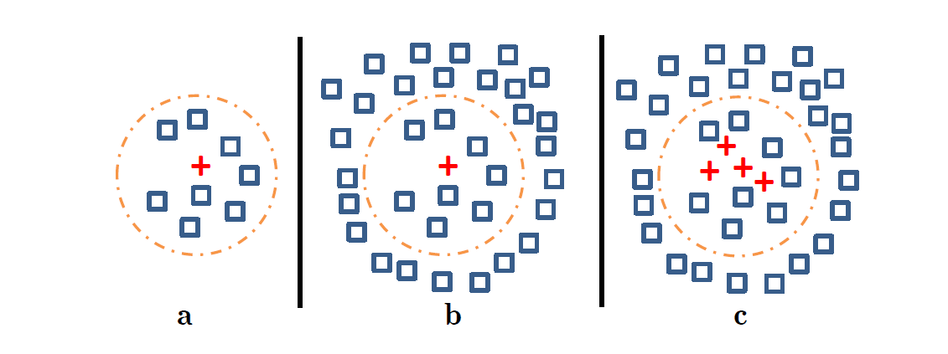
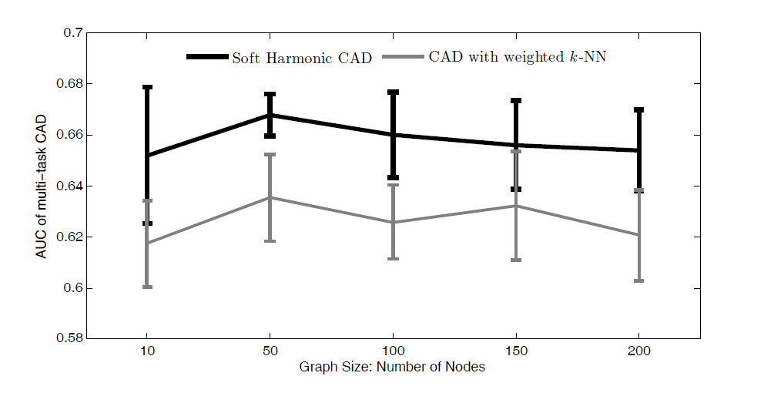
Why not just NN?

Slide 10
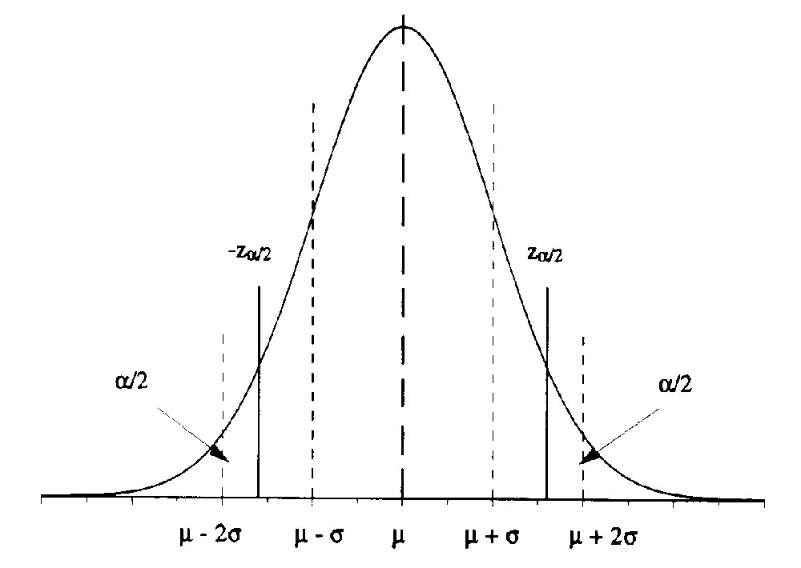
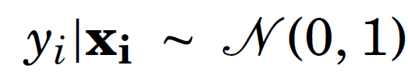
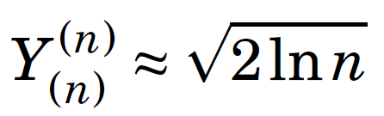
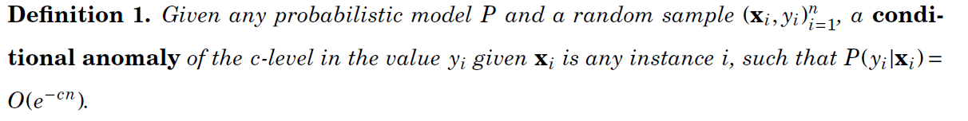
Formal Definition of CAD
Motivation
Assumption:
Number of samples: n
Maximum value:
More samples -> less surprise
Definition:
Practice
Compare rankings
AUC

